Slide 1


Department of Computer Science and Engineering
CS19643 – FOML Project Presentation
EMPLOYEE ATTRITION PREDICTION
Dr.S. Vinodkumar
Professor
Aathmihan S B 210701006
Akshithaa B K 210701024

Slide 2
Abstract
Employee attrition prediction involves the use of statistical and machine learning techniques to anticipate which employees are likely to leave an organization. This predictive modeling process leverages various employee-related data such as demographics, job satisfaction, performance metrics, and organizational factors to identify patterns and risk factors associated with voluntary or involuntary departures. The goal is to provide actionable insights to human resource departments, enabling proactive measures to enhance employee retention and reduce turnover costs. This abstract explores methodologies, data preprocessing techniques, model selection, and evaluation metrics critical to developing robust attrition prediction systems, emphasizing the impact of predictive accuracy on strategic decision-making in human capital management.

Slide 3
Existing System
The existing system for employee attrition prediction relies on traditional methods, such as HR records, surveys, and basic statistical analysis using tools like Excel and simple models like logistic regression. These methods are manual, limited in predictive power, and reactive rather than proactive. They also struggle with scalability and data integration. Transitioning to a machine learning-based system, specifically using a random forest algorithm, enhances predictive accuracy and automates data processing. This approach offers real-time predictions, robust feature importance insights, and comprehensive visualizations, enabling more effective retention strategies and improved workforce stability.

Slide 4
Proposed System
Our proposed system for predicting employee attrition utilizes a random forest algorithm to analyze various employee data, including satisfaction level, last evaluation score, number of projects, average monthly hours, tenure, work accidents, recent promotions, department, and salary. The system preprocesses data by handling missing values, encoding categorical variables, and normalizing numerical features. After training the model on historical data, it predicts the likelihood of attrition for current employees. Key performance metrics like accuracy, precision, recall, and ROC-AUC are used to evaluate the model. This predictive system helps organizations identify at-risk employees and implement targeted retention strategies to reduce turnover.

Slide 5
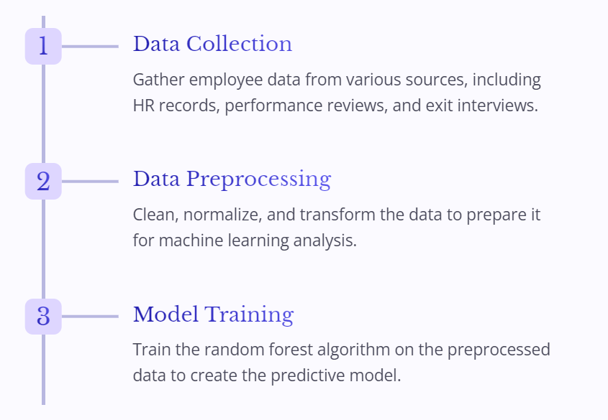
System Architecture

Slide 6
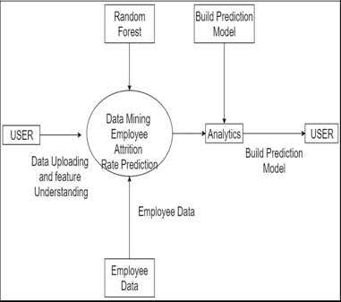
System Architecture

Slide 7
List of Modules
Data Management and Preprocessing
Data Exploration and Visualization
Feature Engineering
Model Evaluation

Slide 8
Functional Description for each modules
Data Management and Preprocessing:In this module, the focus is on ensuring the quality and integrity of the dataset. Duplicate data entries are removed to prevent bias and inaccuracies in the analysis. Additionally, missing values are handled appropriately through techniques such as mean imputation, median imputation, or using predictive models to estimate missing values based on other features. This step is crucial as it lays the foundation for accurate analysis and modeling in subsequent stages. Effective data preprocessing enhances the reliability and robustness of the predictive model by ensuring that it is trained on clean and complete data.

Slide 9
Functional Description of Module
Data Exploration and Visualization: Data exploration involves analyzing the dataset to uncover patterns, trends, and relationships between different variables. Visualizations such as bar graphs, histograms, and scatter plots are utilized to provide insights into the distribution of data and identify potential correlations. These visual representations aid in understanding the underlying structure of the dataset and guide further analysis and feature selection. Exploratory data analysis helps in identifying important features that may influence employee attrition and provides valuable insights for model development and interpretation.

Slide 10
Functional Description of Module
Feature Engineering: Feature engineering is a crucial step in model development where relevant features are selected, transformed, or created to improve the predictive performance of the model. This involves splitting the dataset into training and testing sets to ensure unbiased evaluation of the model. Features such as satisfaction level, number of projects, and tenure are carefully curated and prepared for input into the model. Feature engineering aims to enhance the model's ability to capture meaningful patterns and relationships in the data, leading to more accurate predictions of employee attrition.

Slide 11
Functional Description of Module
Model Evaluation: Model evaluation is the process of assessing the performance of the developed model using appropriate metrics. Precision and accuracy are commonly used metrics to measure the effectiveness of the model in predicting employee attrition. Precision reflects the proportion of true positive predictions out of all positive predictions made by the model, while accuracy measures the overall correctness of the predictions. Evaluation helps in gauging the reliability and effectiveness of the model and provides insights into areas for improvement or refinement.

Slide 12
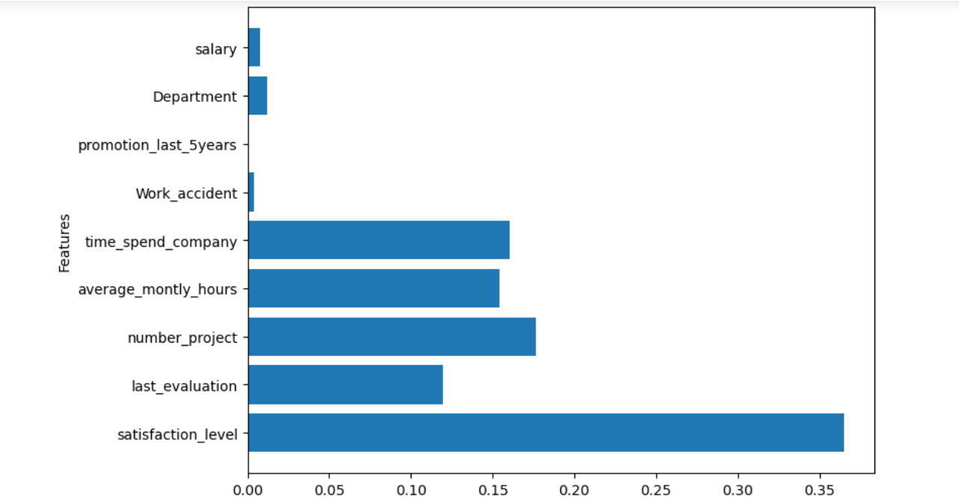
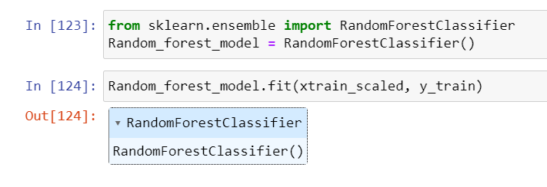
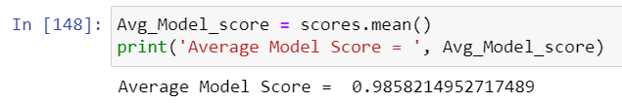
Output

Slide 13
Conclusion
In conclusion, our project on employee attrition prediction using a random forest algorithm provides a robust solution for addressing workforce retention challenges. Through thorough data preprocessing, exploration, and feature engineering, we've developed a predictive model capable of identifying employees at risk of attrition based on various factors. Model evaluation confirms its accuracy and precision, demonstrating its reliability in making informed predictions. With hyperparameter tuning, we've optimized the model's performance, ensuring its practical applicability. By utilizing this predictive tool, organizations can proactively identify attrition risks and implement targeted retention strategies, fostering a more stable and productive workforce. Our project sets the stage for ongoing advancements in employee retention strategies, contributing to organizational resilience and success.

Slide 14
Thank You

